Slide 1
Population and Sampling

Slide 2
Population
It is a larger group from which individual can be selected to participate in study.
Large group from which SAMPLE is to be drawn.
Group of human being such as men ,students, drug addicts or non human being such as educational institutions, hospitals, phenomena.

Slide 3
Census
In some cases, the entire class or group is investigated. The process of examining every member in the population is called census.
But the majority of the time, an entire population cannot be examined due to money, time, and resource constraints.
Measurements of large number of people often affect the quality.
The usual procedure in these instances is to take sample.
Notes:
Using pandas crosstab function

Slide 4
Sample
A subset of population that is representative of the entire population.
To study the characteristics of the population.
If a sample is not representative, the results cannot be generalized to the entire population
A small blood sample taken from a patient can determine the patient’s sugar level because it is truly representative of the whole blood supply.

Slide 5
Sampling
Sampling is the process of selecting sample from the population.
A relatively small number of individuals or measures of objects or events is selected and analyzed in order to find out something about the entire population from which it was selected

Slide 6
Characteristics of Good Sample
Accurate representative of the population.
Time and cost efficient.
A sample should be proportional to the size of the population it should be large enough to represent the population properly.

Slide 7
Provides precise information about the population.
Randomly selected since it makes the selected sample truly representative in character.
Free from bias.
It must possess the least sampling error
(a statistical error that occurs when a researcher does not select a sample that represents the population).

Slide 8
Sampling methods and procedures
The sampling process:
Define the population
Specify the sampling frame
Determine sampling method
Determine sample size
Select the sample

Slide 9
Types
Two types of sampling procedures
Probability sampling
We can specify the probability or likelihood that a given element of the population will be included in the sample.
Non-probability sampling
.We cannot specify the likelihood that a given element from the population will be included inthe sample

Slide 10
Characteristics of probability samples
Always involves chance selection of the elements for inclusion in the sample.
Each element will have a non-zero chance of selection.
Only with a probability sample can we estimate the likelihood that a sample will represent the population.
We can estimate the error associated with the sample
Notes:
How well

Slide 11
Characteristics of non Probability samples
We have no assurance that every element of the population has a chance to be included.
We do not have the ability to estimate the error associated with the sample drawn

Slide 12
Process
The sampling process comprises several stages :
Defining the population of concern
Specifying a sampling frame, a set of items or events possible to measure
Specifying a sampling method for selecting items or events from the frame
Determining the sample size
Implementing the sampling plan
Sampling and data collecting

Slide 13
Types of probability sampling
Simple random sampling
Systematic random sampling
Stratified Randon sampling
Cluster/area random

Slide 14

Simple random sampling
When population is rather uniform (e.g.school/college students, low-cost houses)
Every element in the population will have an equal chance of being selected.
Tables of random number population or computer generated random numbers are used.
Simplest, fastest, cheapest

Slide 15
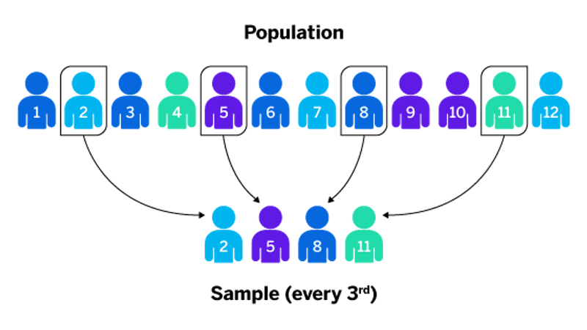
Systematic random sample
Initial starting point is selected randomly, then every nth number on the list is selected.
The population is arranged in a particular order either ascending or descending order.
Example:
You wish to take a sample of 1,000 from a list consisting of 200,000 names. Using
systematic selection, every 200th name from the list will be drawn.
sampling interval = 200
200,000/1,000 = 200

Slide 16
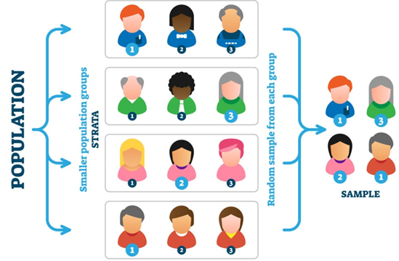
Stratified sampling
Break population into groups or strata and then take random sample within each group.
Treat each stratum as a separate subpopulation for sampling purposes.
Strata are homogeneous within and heterogeneous between (or maximally different from each other).

Slide 17
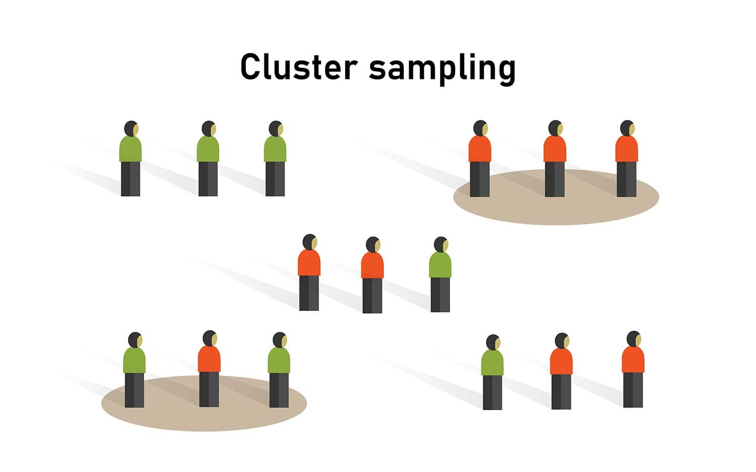
Cluster/Area Sampling
The population is divided into mutually exclusive groups(like union councils/towns/cities/provinces/countries/pacific regions).
The researcher draws the sample from each groups to analyze.
Two-stage cluster {cluster first, Then stratify within cluster)
.
Efficient from administrative perspective

Slide 18
Types of Non probability sampling
Convenience sampling
Judgement sampling
Quota sampling
Snowball

Slide 19
Convenience Sampling
Selecting individuals who are easiest to reach (e.g., surveying people at a shopping mall).
Judgmental (Purposive) Sampling
Selecting participants based on expert judgment about who would be most useful for the study.

Slide 20
Snowball Sampling
Participants refer other participants, useful for hard-to-reach
Example populations (e.g., studying drug users)

Slide 21
Quota sampling is a non-probability sampling method where participants are selected to match key characteristics of the population.
Proportional Quota Sampling: Ensures sample proportions match the population (e.g., 40% women, 60% men).
Non-Proportional Quota Sampling: Ensures a minimum number of cases in each category, without strict proportionality, to adequately represent smaller groups

